Slide 1




Regular Expressions
/^Hel{2}o\s*World\n$/
Advanced Java
SoftUni Team
Technical Trainers
Software University
http://softuni.bg

Slide 2

Table of Contents
Regular Expressions
Characters
Operators
Constructs
Regular Expressions in Java
Helpful Resources

Slide 3
Questions
sli.do #6772

Slide 4
Character Classes
[nvj] matches any character that is either n, v or j
[^abc] – matches any character that is not a, b or c
[0-9] - Character range: Мatches any digit frm 0 to 9
node.js v0.12.2
Abraham Lincoln
In 1519 Leonardo da Vinci died at the age of 67.

Slide 5
Character Classes (2)
\w – Matches any word character (a-z, A-Z, 0-9, _)
\W – Matches any non-word character (the opposite of \w)
\s – Matches any white-space character
\S – Matches any non-white-space character (opposite of \s)
\d – Matches any decimal digit
aBcd 09_ &*^ Ю-Я
aBcd 09_ &*^ Ю-Я
Notes:
\w – Matches any word character (a-z, A-Z, 0-9, _)
\W – Matches any non-word character (the opposite of \w)
\s – Matches any white-space character
\S – Matches any non-white-space character (opposite of \s)
\d – Matches any decimal digit
\D – Matches any non-digit character (opposite of \d)

Slide 6
Quantifiers
* - Matches the previous element zero or more times
+ - Matches the previous element one or more times
? - Matches the previous element zero or one time
+359885976002
+
\+\d*
=>
+359885976002
+
\+\d+
=>
\+\d?
=>
+359885976002
+

Slide 7
Character Escapes
Sometimes you will need to look for special characters like new lines or tabulations
This is a “tab”
Then we have a new line
Name: Peter
Phone: +359882042353
We can use character escapes in our RegEx like that:
Name:\t\w+\nPhone:\s*\+\d+

Slide 8

Anchors
^ - The match must start at the beginning of the string or line
$ - The match must occur at the end of the string or before \n
Example – username validation pattern:
Note: Test one by one, $ asserts string end
^\w{6,12}$
jeff_butt
short
johnny
too_long_username
!lleg@l_ch@rs

Slide 9
Grouping Constructs
(subexpression) - captures the matched subexpression and assigns it a number
(?<name>subexpression) - Captures the matched subexpression into a named group
\d{2}-(\w{3})-\d{4}
=>
22-Jan-2015
X`
\d{2}-(?<month>\w{3})-\d{4}
=>
22-Jan-2015
Names the captured group 'month'

Slide 10
Grouping Constructs (2)
(?:subexpression) – Defines a non-capturing group
^(?:Hi|hello),\s*(\w+)$
=>
Hi, Peter
Notes:
Non capturing groups are necessary when you want to exclude alternations captured as a group.

Slide 11
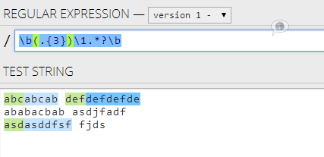
Backreference Constructs

Slide 12
Backreference Constructs
\number – matches the value of a numbered subexpression
\k<name> – matches the value of a named expression
22-12-2015
05/08/2016
\d{2}(-|\/)\d{2}\1\d{4}
=>
22-12-2015
05/08/2016
\d{2}(?<del>-|\/)\d{2}\k<del>\d{4}
=>

Slide 13

Playing with RegEx
Exercises in class

Slide 14
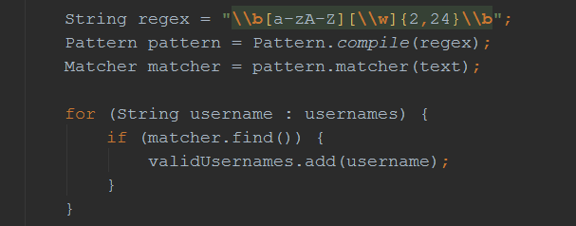
Regular Expressions
Using Built-In Regex Classes

Slide 15
Regex
Java supports a built-in regular expression classes
java.util.regex.Pattern
java.util.regex.Matcher
Pattern pattern = Pattern.compile("a*b");
Matcher matcher = pattern.matcher("aaaab");
boolean match = matcher.find();

Slide 16
Validating String By Pattern
Pattern.matches(String pattern, String text) – determines whether the text matches the pattern
String text = "Today is 2015-05-11";
String pattern = "\\d{4}-\\d{2}-\\d{2}";
bool containsValidDate = Pattern.matches(pattern, text);
System.out.print(containsValidDate); // true

Slide 17
Checking for a Single Match
find() – gets the first match that corresponds to the pattern
String text = "Nakov: 123";
String pattern = "([A-Z][a-z]+): (\\d+)";
Pattern regex = Pattern.compile(pattern);
Matcher matcher = regex.matcher(text);
matcher.find();
System.out.println(matcher.groupCount()); // 2
System.out.println("Matched text: " + matcher.group(0));
System.out.println("Name: " + matcher.group(1)); // Nakov
System.out.println("Number: " + matcher.group(2)); // 123

Slide 18
Replacing With Regex
replaceAll(String replacement) – replaces all strings that match the pattern with the provided replacement
String text = "Nakov: 123, Branson: 456";
String pattern = "\\d{3}";
String replacement = "999";
Pattern regex = Pattern.compile(pattern);
Matcher matcher = regex.matcher(text);
String result = matcher.replaceAll(replacement);
System.out.println(result);
// Nakov: 999, Branson: 999

Slide 19
Splitting With Regex
split(String pattern) – splits the text by the pattern
Returns String[]
String text = "1 2 3 4";
String pattern = "\\s+";
String[] results = text.split(pattern);
System.out.print(String.join(", ", results)); // 1, 2, 3, 4

Slide 20
Built-in RegEx
Exercises in class

Slide 21
Helpful Resources
https://regex101.com and http://regexr.com – websites to test Regex using different programming languages
http://docs.oracle.com/javase/7/docs/api/java/util/regex/Matcher – a quick reference for Regex from Oracle
http://regexone.com – interactive tutorials for Regex
http://www.regular-expressions.info/tutorial.html – a comprehensive tutorial on regular expressions

Slide 22

Summary
Regular expressions describe patterns for
searching through text
Define special characters, operators and
constructs for building complex patterns
Powerful tool for extracting specific data from text or validating strings (e.g. email/username validator)
Java provides a built-in Regex classes
Supports matching, validating, splitting and replacing strings by a pattern

Slide 23









Regular Expressions
https://softuni.bg/trainings/1377/advanced-java-may-2016

Slide 24

License
This course (slides, examples, demos, videos, homework, etc.) is licensed under the "Creative Commons Attribution-NonCommercial-ShareAlike 4.0 International" license
Attribution: this work may contain portions from
"C# Fundamentals – Part 1" course by Telerik Academy under CC-BY-NC-SA license
"C# Fundamentals – Part 2" course by Telerik Academy under CC-BY-NC-SA license

Slide 25





Free Trainings @ Software University
Software University Foundation – softuni.org
Software University – High-Quality Education, Profession and Job for Software Developers
softuni.bg
Software University @ Facebook
facebook.com/SoftwareUniversity
Software University @ YouTube
youtube.com/SoftwareUniversity
Software University Forums – forum.softuni.bg

